Slide 1
What to expect . . . When a loved one is arrested
Daryle Brown
Lead Organizer – The Next Movement committee

Slide 2
Agenda
The Next Movement committee
[WHO WE ARE]
What to Expect When a Loved One is Arrested: A Short History
Summary of What’s In the Book?
Conversation From the Front Line
1st Defense Legal Aid
Coalition To End Money Bail
Public Defender’s Office
Questions and Answers
Notes:
Rev. Dr. Danielle J. Buhuro, Senior Pastor

Slide 3
Notes:
The Next Movement (TNM) was born as a response to a visit and lecture by Michelle Alexander at Trinity United Church of Christ, December 5, 2010 and a Convening held December 11, 2010, that began to form an action plan to respond to mass incarceration in America.
TNM, organized as a committee of the Trinity UCC Prison Ministry, is comprised of Americans of all races and religions, who view mass incarceration as the key human rights issue of our time, and are committed to building the mass movement necessary to alleviate it. Through education and building awareness, through organizing individuals and organizations, we are dedicated to mobilizing the ‘people power’ necessary to make the systemic changes required.

Slide 4
The Incarceration Epidemic
2.2 Million incarcerated today versus 300,000 in 1982 . . . What Happened? Big Mistakes!
War on Drugs
3 Strikes Laws
“Tough on Crime” legislators
Anti-Reintegration laws
Undocumented Immigrant Detention Policies
Prison Industrial Complex
The Near Elimination of Public Mental Health Facilities

Slide 5
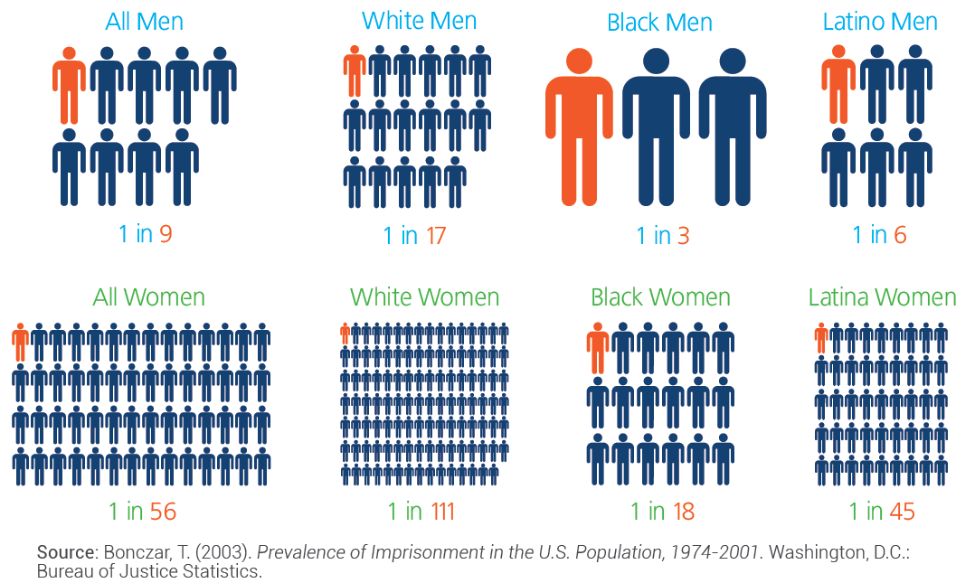
Who are we locking up? Lifetime likelihood of Imprisonment

Slide 6
Our Focus Story . . .
Notes:
Imagine you are at a picnic on a beautiful day, along a local river. The place is crowded, everyone enjoying the day and the company, when someone notices a child floating in the water. There is panic as they rush to the child’s aid. Eventually they resuscitate the child, wrap it in a warm sweater, perhaps offer it some nourishment, and just about the time they relax . . . another child is spotted in the river.
The mad scene repeats itself, and then . . . another child. Soon everyone along the shore is exhausted as the children keep coming. There is no one to spare; it is all consuming.
That is the state of our support infrastructure, stretched to the limits of our funding, endurance and human capital, trying to address the many faceted problems of those we are trying to keep out of prison, our brothers and sisters in prisons across America, and those returning to our communities. Training, housing, jobs programs, food, counseling, family issues, the list goes on . . . but we must find a way to tear off some resources to move upstream and stop whoever, whatever, from throwing our people into the river.
Note: Variations of this story are often credited to Saul Alinsky, a noted community organizer and activist.

Slide 8
. . . Arrested: Quick history
This version has been 8 years in the making
Original was developed by Reconciliation Ministries, Inc., Nashville, TN
Our root version was written by Lutheran Correction Ministries, and was given to us by Attorney Lynne Chambers
TNM’s first version was researched by Attorney Deidre Cato
TNM’s Final Version was a project for our intern, and 2016 Graduate of Northwestern University Law School, Branden Zollar, reviewed by Attorney Ruth McBeth, and edited by Olivia Chase and Daryle Brown

Slide 9
What’s inside?
The Arrest
Probable Cause
Miranda Warning
What’s Left Behind
Booking
Phone Calls
Bond and Bail
Bail
Bond
Property Bond
Credit Cards
Assignment of Bail
Electronic Monitoring
Day Release
Home Confinement
Courts
Family Involvement
Public Defender of Private Counsel?
Public Defender Eligibility
Finding Private Counsel
Preliminary Hearing
Arraignment
Pre-Trial Motions
Negotiated Pleas
Trial
Sentencing
Notes:
Phone Calls – Once jailed, a defendant can only make collect calls

Slide 10
What’s inside?
Juvenile Court
Detention Hearing
Unique Characteristics of Juvenile Court
Legal Counsel
Juvenile Department of Corrections
What Happens Next? (if found guilty)
Reception and Classification Centers
Visitation Considerations
Prison Searches
Self Care
Other Considerations
Financial
Phone Calls
Visiting Expenses
Relationships
Children and Prisons
Children’s Concerns
Children and Visiting
Spiritual
A Prayer
Other Books and Resources
Notes:
Phone Calls – Once jailed, a defendant can only make collect calls

Slide 11
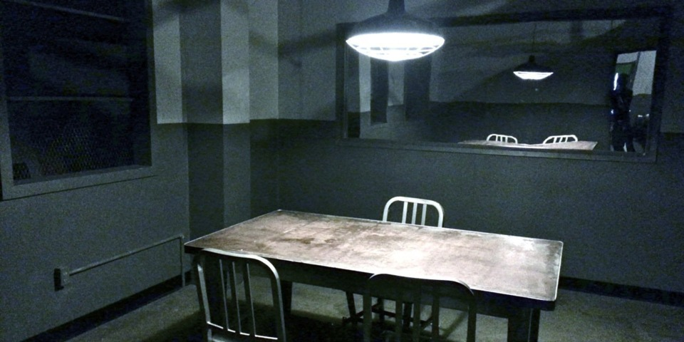
The Front line

Slide 12
Conversation From the Front Line
1st Defense Legal Aid

Slide 13
Conversation From the Front Line
[NAME]– Attorney Public Defender

Slide 14
Questions and Answers

